Slide 1




Week 1 readings summary

Slide 2
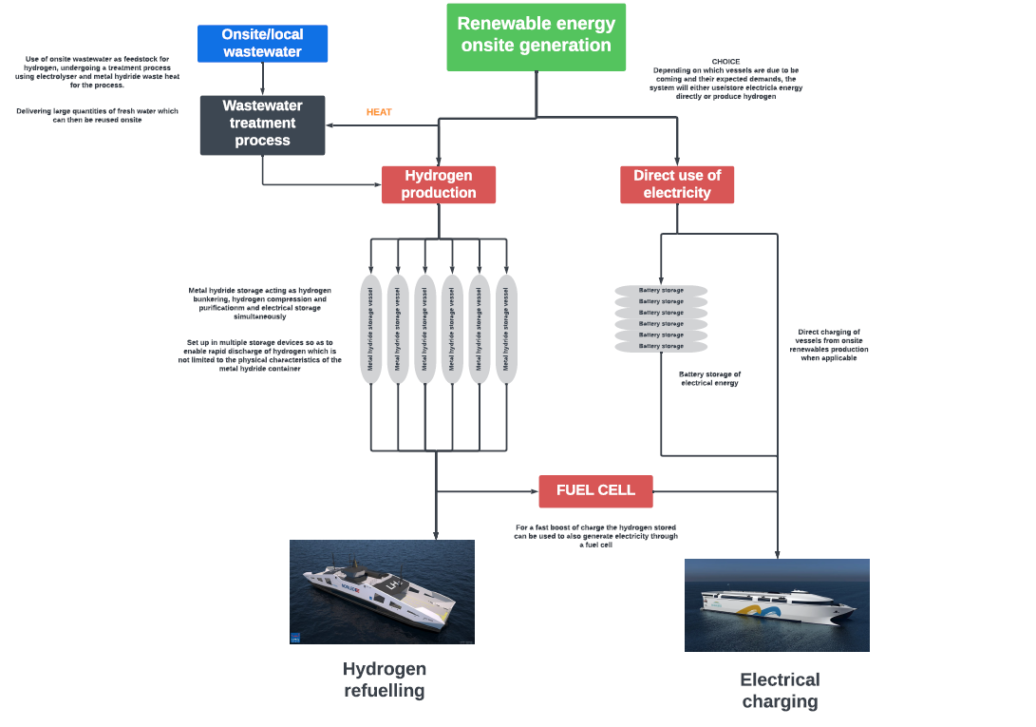

Slide 3

Environment Agency
Guidance focuses on the installation of and running of a hydrogen production plant, and the required considerations.
Main considerations:
Environmental protection (Pollution Prevention and Control)
Environmental performance (Energy & Water demand and efficiency, Emissions to the environment)
Notes:
All sizes of industrial plant installations producing hydrogen by electrolysis of water are permitted under: Environmental Permitting (England and Wales) Regulations 2016, specifically Part A (1) 4.2 (a)(i) inorganic chemicals activity in England and Wales.
Since there are no existing best available techniques (BAT) reference documents (BREFs) or guidance which specifically cover hydrogen production by electrolysis of water, Article 14(6) of the Industrial Emissions Directive (IED) must be followed, which states that the competent authority will consultant with the operator to set the permit conditions based on the BATs of the activities or processes concerned.

Slide 4
Environmental protection and performance
Should describe measures to minimise the environmental impact of the operation of the hydrogen production plant and its associated activities.
These include:
Maximising energy and process efficiency
Minimise the quantity of water used
Identify how electrical supply issues affect availability and variability
Hydrogen purification
Reducing emissions to the atmosphere and water
Waste management

Slide 5
Main transferrable points to CMDC project
Technical and Economic feasibility (Strand 3)
The operation of a hydrogen production plant is related to techno-economic feasibility.
Energy and process efficiency, water efficiency, hydrogen purification, and managing emissions is important in complying with current Environmental and Pollution regulations whilst making hydrogen more cost-effective to begin to rival fossil fuels.
Therefore, this document is useful to the CMDC project as it outlines the considerations that companies must make and the regulations they must comply with when developing infrastructure on land.

Slide 6

Hydrogen Strategy Delivery Update
Document presents the progress that the Government and industry have made in delivering the Hydrogen Strategy. It also sets out the steps outlined to create a UK hydrogen market.
Main points
Goals to scale up the UK Hydrogen Economy
Strategic vision and delivery focus to 2035
Maritime industry and blending
Not a lot of regulation mentioned here, mostly plans and ambitions.
Notes:
Scaling up the hydrogen economy includes producing, transporting, storing, an using hydrogen requiring new technology, infrastructure, supply chains, investment, jobs, and skills. The CMDC project is heavily involved in this as it is conducting techno-economic feasibility studies on the infrastructure side of it on land.
Strategic vision and delivery focus to 2035 – hydrogen production must comply with the UK Low Carbon Hydrogen Standard which provides clarity about the type of hydrogen production the government intends to support. However, part of the roadmap is to allocate 6 GW of the 2030 ambition to electrolytic production. Hence, the CMDC project is not only politically and industrially relevant, but also necessary to meet these goals by 2030.

Slide 7
Main transferrable points to CMDC project
Maritime sector is a large component of the delivery update, and several plans outline the Government’s aims to decarbonise the sector using hydrogen technologies.
Blending could be applied in a maritime context, but this is dependent on economic feasibility, making the CMDC project relevant.
Overall, the CMDC project is aligned with the Government’s hydrogen production aims by analysing techno-economic feasibility which is important for the development of hydrogen technologies.
Notes:
Blending refers to the potential for hydrogen to blend into the GB gas distribution networks and gas transmission system.
Blending will require comprehensive economic assessments to ensure that it is economically feasible alongside being safe. The feasibility study as part of the CMDC project contributes to this and is important because blending will be a necessary infrastructure requirement in the future to facilitate the widespread application of hydrogen.

Slide 8

Maritime Hydrogen
Document investigates the technical and economic regulatory environments to identify interventions to support the uptake of hydrogen technology into the maritime sector.
Outlines regulatory issues, stakeholder assessments of current policy, and provides recommendations.
Notes:
RHC is an independent expert committee sponsored by DSIT that identifies the implications of technological innovation and provides government with impartial expert advice.

Slide 9
Introduction
Research has shown that the technology to use hydrogen fuel in maritime vessels has been well developed, but the lack of alignment between stakeholders and regulators act as barriers.
Beyond regulation, both fuel and vessel costs for hydrogen propulsion are likely to remain higher than for fossil fuels.
Therefore, techno-economic feasibility studies like the CMDC project is important to improving the feasibility of hydrogen which incentivises net-zero shipping.

Slide 10
Stakeholder and Sector Assessment
The lack of development of regulatory systems, delays in infrastructure development, and commercial barriers are creating a first-mover disadvantage for companies.
Low private investment in R&D has resulted to a long-term of innovation in the marine sector.
Uncertainty from stakeholders
Government intervention needed to mandate or incentivise net-zero shipping to grow demand for hydrogen fuel. Energy (Security) Bill
Notes:
Uncertainty from stakeholders – came from a discussion with an industry stakeholder discussing that the UK has failed to capture any meaningful value from the offshore wind-turbine supply chain, despite having a sizable market demand and a pioneering role. This is a structural weakness that could be replicated for hydrogen vessels.
Energy (Security) Bill – aims to enable hydrogen producers to overcome the operating cost gap between low-carbon hydrogen and fossil fuels from 2025.

Slide 11
Innovation funding landscape and international activity
First two rounds of CMDC favoured research-oriented applications whereas round 3 is more focused on later-stage research and development, which is needed.
2021 conference identified the need for R&D to address vessel-related issues such as hydrogen storage. Relevance to CMDC project in metal hydride storage.
There is a consensus that there has been limited development of hydrogen storage and fuelling infrastructure.
Notes:
2021 conference – International Partnership for Hydrogen and Fuel Cells in the Economy stated.

Slide 12
Key Regulatory Issues
Risk-based design
Differences in risk-based evaluations by various bodies
Overly cautious approach to regulation
Port infrastructure
Notes:
Marine sector has not had significant innovation for many years because shipbuilding is largely prescriptive and based on checklist regulation. Therefore, new checklists based on the evaluation of the specific risks presented by hydrogen technology are need. Furthermore, shipbuilders have to carry out extensive risk evaluations to meet the IGF code, (safety code for ships) and this is unfamiliar to a lot of shipbuilders, contributing to further uncertainty.
Stakeholders have said that there have been difficulties with getting approval for hydrogen ship designs due to the lack of consistency between engineering consultancies, class societies, and the MCA (Marine and Coastguard Agency)
MCA have also been said to have an overly cautious approach, resulting in delays and sometimes even the termination of projects, such as the Orkney ferry project.
Lack of port infrastructure due to many port operators being privately owned who rent space to tenants who are then expected to build any necessary infrastructure. Creates a ‘chicken-and-egg’ problem because ports won’t invest in shore-power unless they know ships are equipped and willing to use hydrogen. At the same time, ship owners won’t invest until they see that there are ports that they can connect too.

Slide 13
RHC’s recommendations and rationale
Majority of recommendations aim to address the current regulatory issues such as:
Producing further guidelines for the designs of hydrogen propulsion vessels
Establish guidelines for ports to plan appropriately for the required transition to zero-carbon shipping
Create a Centre or Taskforce comprising key stakeholders that focuses on standards and infrastructure delivery
Other recommendations:
Ensure future public R&D investment such as CMDC are made at a scale comparable to international competitors.

Slide 14
Key transferrable points to CMDC project
The document talks extensively about the lack of infrastructure currently available to support the operation of hydrogen vessels, which acts as a significant barrier.
Unclear regulations and privately owned port operators are currently acting as significant barriers, creating a ‘chicken-and-egg’ problem.
Techno-economic feasibility is key to addressing this because it will incentivise ports to implement the appropriate infrastructure which will in turn incentivise ship owners to equip hydrogen propulsion to their ships.

Slide 15
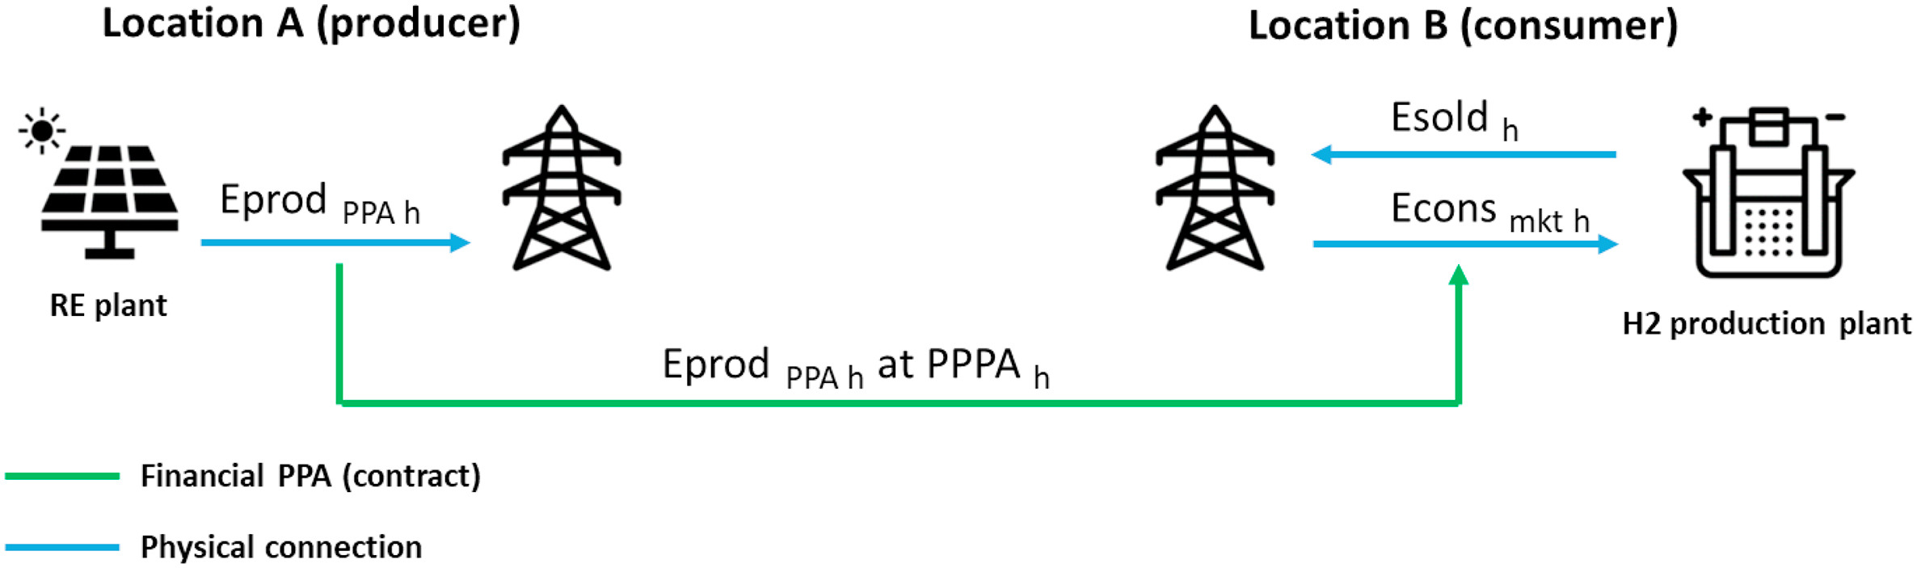
Additional readings into techno-economic feasibility
PPAs have emerged as a way of reducing the CAPEX of hydrogen production plants, as well as providing long-term stability to typically volatile electricity prices.

Slide 16
Additional readings continued..
Aside from the feasibility of green hydrogen production itself, it’s use in the maritime industry is dependent on other technical issues involving the design of the hydrogen supply chains.
By 2030, the hydrogen price is expected to decrease as a result of technological improvements, economies of scale, and learning by doing as well as the introduction of carbon tax policies for emitted CO2 from the EU Emission Trading System.
These will hopefully decrease the cost of hydrogen to make it competitive with the Very Low Sulfur Fuel Oil used as marine fuel currently.
Notes:
Whether or not it is green depends not only on the primary source of the electricity, but also on its transportation and distribution to end users.

